Slide 1

Real Time Mask Detection System
Submitted by:
Kritartha Patowary (201800006)
Amit Kumar Verma (201800475)
Shubhans Shukla (201800094)
Under the supervision of:
Dr. Biswaraj Sen
Assistant Professor
Department of Computer Science and Engineering
Sikkim Manipal Institute of Technology,
Majitar, Rangpo, East Sikkim – 737132

Slide 2
ABSTRACT
Enforcing mask mandate manually is cumbersome and requires a lot of manpower.
A solution is proposed by this project to solve this problem by providing an automated system to detect faces with mask and without mask.
This is done by building a deep learning model and then using it for real-time mask detection.
Finally, this system is implemented with an Arduino to provide entry to people with mask.

Slide 3
INTRODUCTION
Masks are a key measure to suppress transmission of Covid 19.
People need to wear mask in places of mass gathering.
To enforce this, traditionally we would require a lot of manpower
To eliminate this problems, our mask detection system should be implemented on various entrances.
This system detects whether an individual is wearing a mask or not. Then allows him entry accordingly.

Slide 4
Literary Survey
SL.No | Author | Paper and Publication Details | Findings | Relevance to the project
1 | Zhao Luo, Jia Li, Shiming Ge and School of Cyber Security, State Key Laboratory of Virtual Reality Technology, Computer Vision Foundation, 2017 | Detecting Masked Faces in the Wild by Zhao Luo, Jia Li, Shiming Ge and School of Cyber Security, State Key Laboratory of Virtual Reality Technology and Systems published paper from 1-4 | The problem of face detection in the wild have been explored in many existing researches, and the corresponding face detectors have been tested on datasets of normal faces. However, the ‘real world’ scenarios are much more challenging than expected for containing faces captured at unexpected resolution and illumination. In particular, the detection of masked faces is an important task that needs to be addressed to facilitate applications such as video surveillance. | The Detecting Masked Faces will work over the database provide to it and will use its presets to validate with the ongoing surveillance and to distinguish between the one with mask and others without.

Slide 5
Literary Survey
SL.No | Author | Paper and Publication Details | Findings | Relevance to the project
2 | Toshanlal Meenpal, Ashutosh Balakrishnan & Amit Verma of Dept. of Electronics and Telecomm. National Institute of Technology Raipur, India, International Conference on Computing, Communications and Security, 2019 | Facial Mask Detection using Semantic Segmentation by Toshanlal Meenpal, Ashutosh Balakrishnan & Amit Verma of Dept. of Electronics and Telecomm. National Institute of Technology Raipur, India | They were able to generate accurate face masks for human objects from RGB channel images containing localized objects. They demonstrated their results on Multi Human Parsing Dataset with mean pixel level accuracy. Also the problem of erroneous predictions has been solved and a proper bounding box has been drawn around the segmented region. Proposed network can detect non frontal faces and multiple faces from single image. The method can ﬁnd applications in advanced tasks such as facial part detection. | This paper proposes a model for face detection using semantic segmentation in an image by classifying each pixel as face and non-face

Slide 6
PROBLEM DEFINITION
The key challenge is to ensure that people enter places of mass gatherings such as schools, colleges, malls, offices only after they wear a mask.
This would require a lot of manpower as for every entrance we would require one guard checking everyone.
Rather, we propose an automated face mask detection system to solve this problem

Slide 7
Solution Strategy
Our face mask detection model is built using MobileNetV2
A dataset with pictures of faces with mask and without mask is used to train our deep learning model.
Frontal Face Detector model of DNN module is used to detect faces in video live stream.
Then our mask detector model is implement to detect mask on these faces.

Slide 8
Solution Strategy
To connect and communicate with an Arduino which is connected to a servo motor, we use PySerial library .
The servo motor controls a door.
If the model predicts the face to be with mask, we send a character to the Arduino. We send another character to the Arduino if the prediction is without mask.
The Arduino acts upon the character we send and operates the servo motor accordingly.

Slide 9
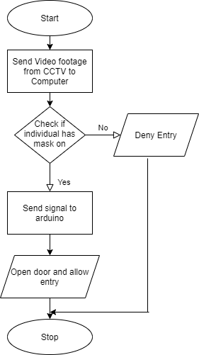
DESIGN

Slide 10
Face Mask detection flow from webcam
Initialize the video/web cam
Extract image from the frames
Load face detection model
Face Image
Open/Close gate using Arduino
Display face with box identification and below shows mask classification
Load mask detection model (MobileNetV2)
Apply Image preprocessing

Slide 11
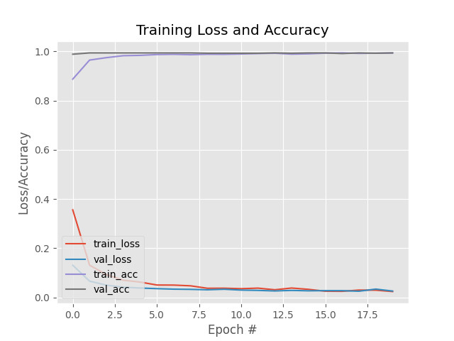
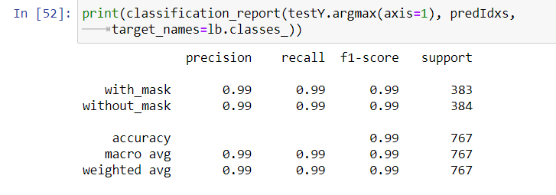
Experimental Results
Classification Report

Slide 12
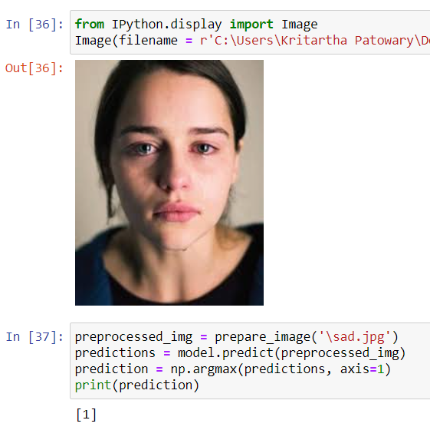
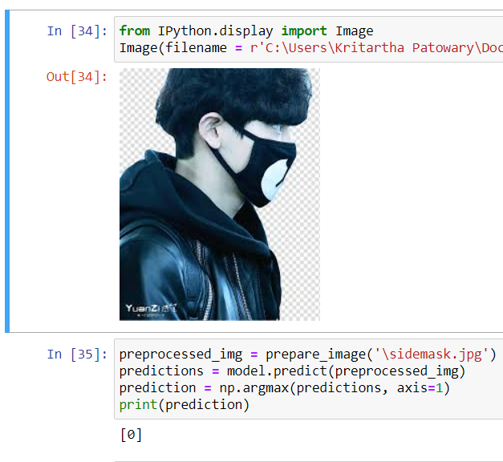
Fig: Prediction 1
Fig: Prediction 2
Note: 1 in output corresponds to the class “without mask” and 0 corresponds to the class “with mask”.

Slide 13
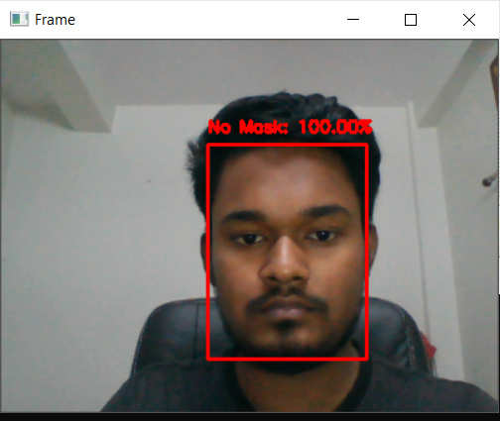
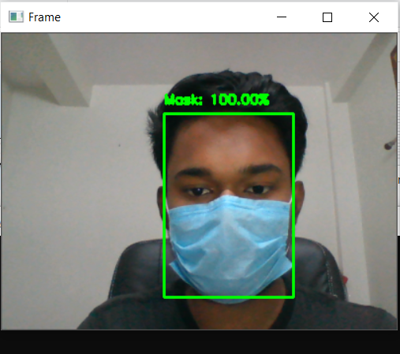
Mask detection in live video stream
Snippets from predictions done by our model in live video stream

Slide 14
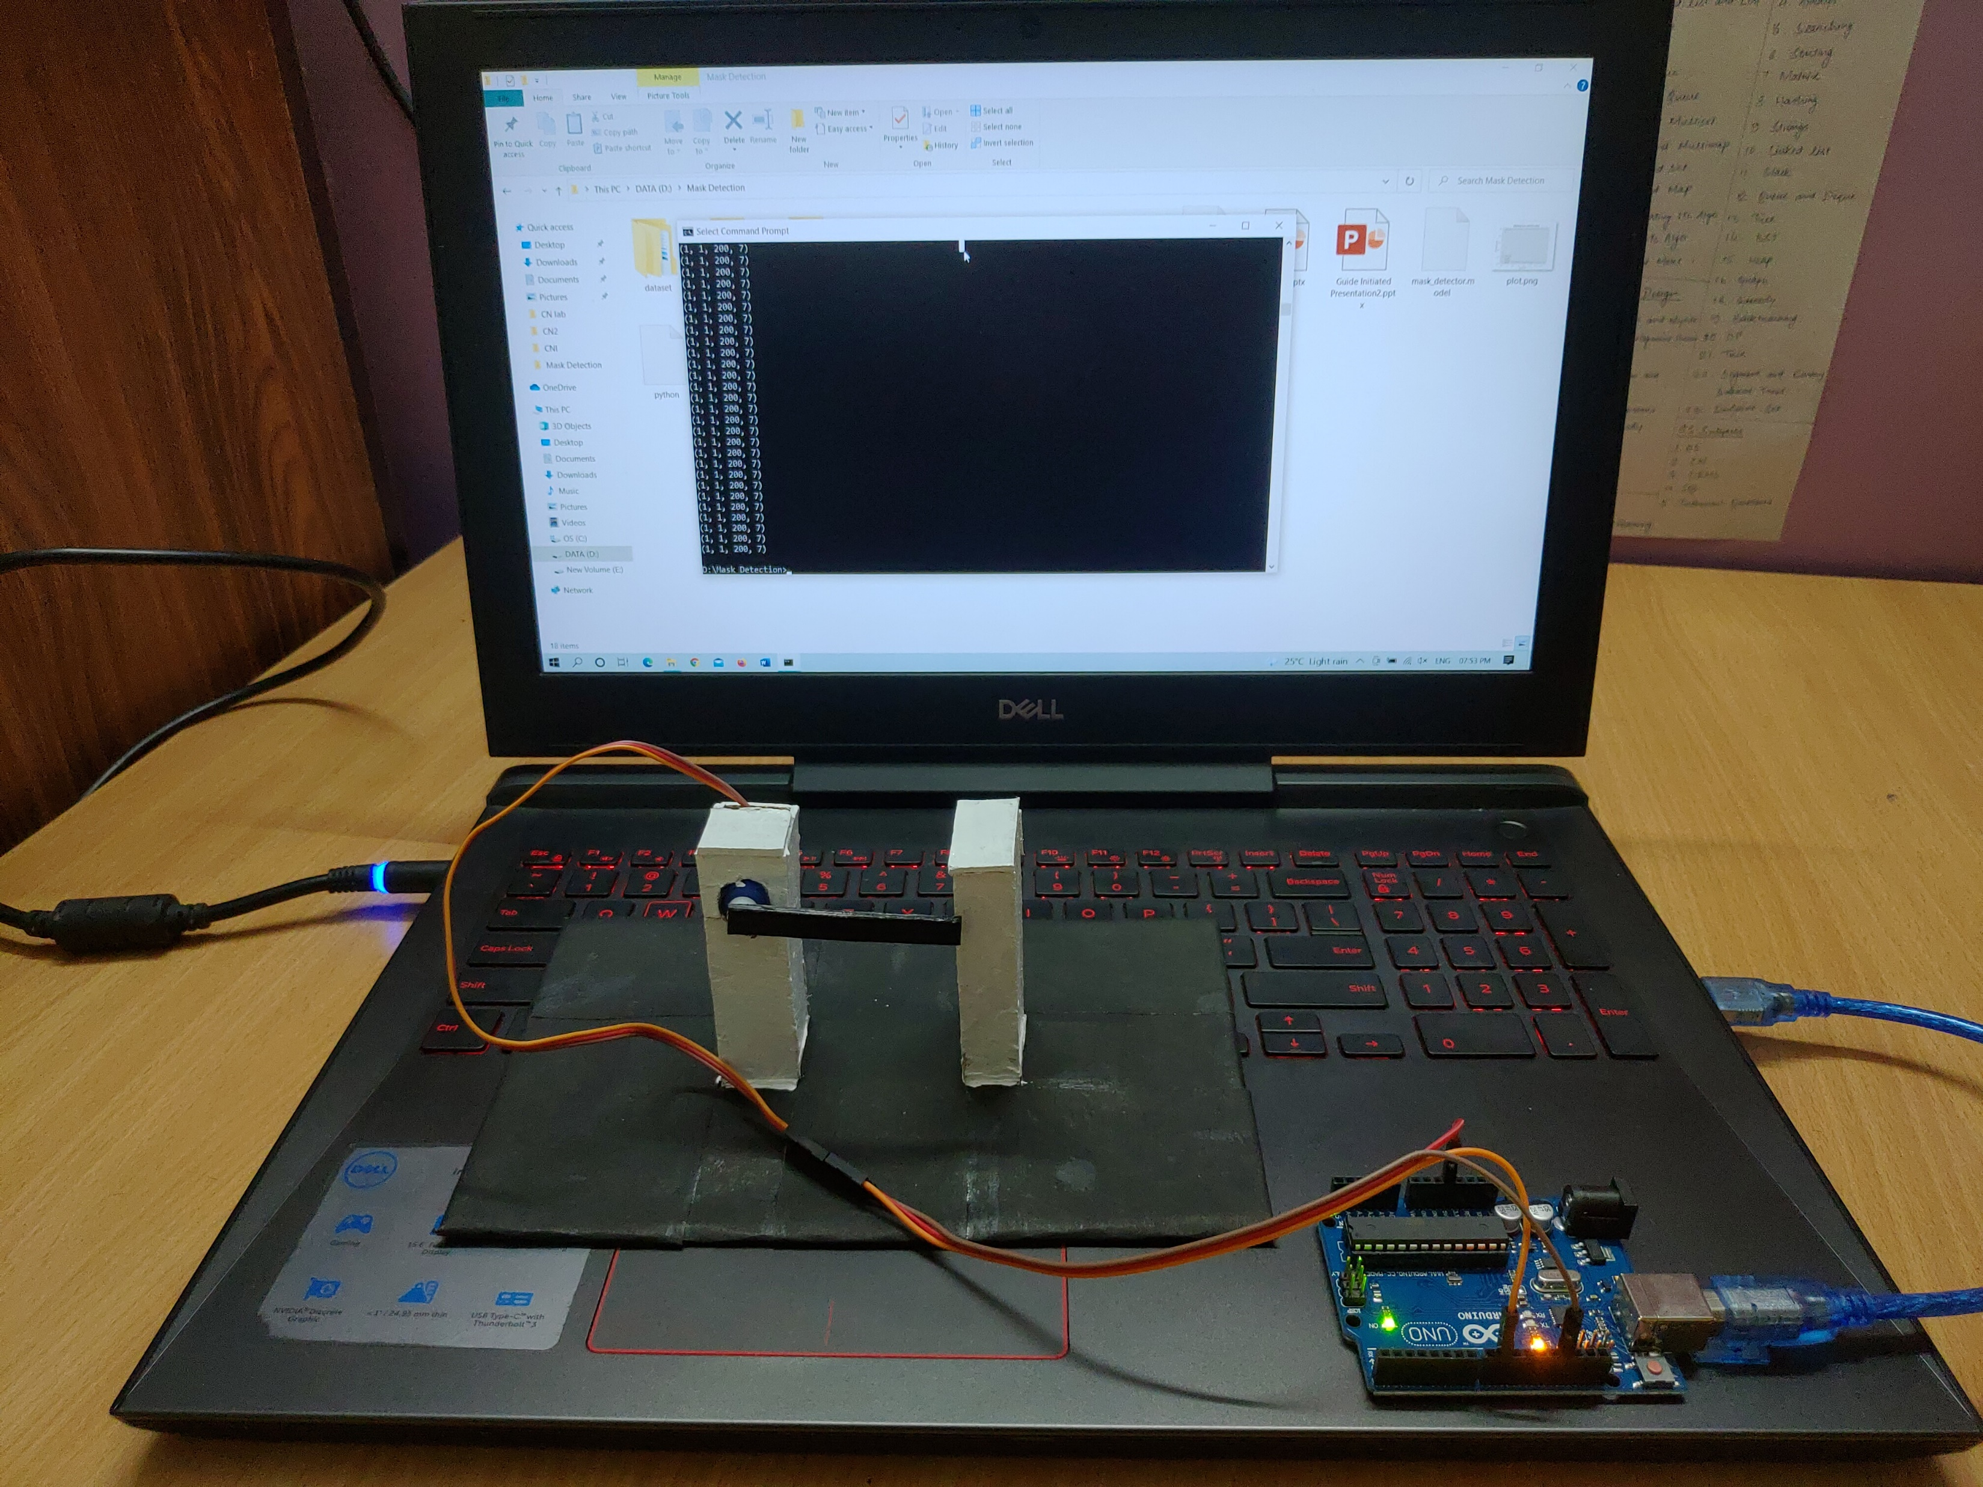
Setup to display the working of our project

Slide 15
Video to be inserted here

Slide 16
Conclusion
Our face mask detection model has been successfully built with a pretty decent accuracy.
This model has also been successfully added in live video stream.
The Arduino is working as intended in accordance with the mask detection system.
Hence the model can properly detect faces with mask and without mask and then take decisions according to it in real time.

Slide 17
Limitations
This system would not work properly in low light condition.
Difficult to take decision when multiple faces are present in front of the camera.
Future Scope
The model can be further optimized to take decision in case of multiple faces.
The system can now be implement in real life.

Slide 18
Gantt Chart
ACTIVITY | NOVEMBER 2020 | DECEMBER 2020 | JANUARY 2021 | FEBURARY 2021 | MARCH 2021 | APRIL 2021 | MAY 2021
LITERATURE SURVEY
PROBLEM IDENTIFICATION
DESIGN
IMPLEMENTATION
TESTING
REPORT AND DOCUMENTATION
Achieved Work
Proposed Work

Slide 19
Acknowledgment
We thank our guide Mr. Biswaraj Sen whose valuable guidance and kind supervision throughout the course shaped the present work as it shows.
We thank Prof. (Dr.) Kalpana Sharma, H.O.D, CSE Department, Sikkim Manipal Institute of Technology for giving us the opportunity to work on this project and provided all support required.
We thank Dr. Sandeep Gurung, Mr. Santanu Kr. Misra, Mr. Biraj Upadhyaya and Ms. Nitisha Pradhan our project coordinators for elevating, inspiration and kind supervision in completion of our project.
We would also like to thank any other staff of CSE Department for giving us continuous support and guidance that has helped us in completion of our project.

Slide 20
REFERENCES
Shiming Ge, Jia Li, Qiting Ye, Zhao Luo. (2017). Research Paper on Detecting Masked Faces in the Wild with LLE-CNNs State Key Laboratory of Virtual Reality Technology and Systems. China: CVF
Toshanlal Meenpa, Ashutosh Balakrishnan, Amit Verma. (2019). Facial Mask Detection using Semantic Segmentation. India : International Conference on Computing, Communications and Security

